Slide 1
Wells Fargo Bank
Case Study
Made By- Aditya Vijay Singh
Nakul Rathi
Satyendra Pal
Mahesh Kumar

Slide 2
Case Study: Wells Fargo Banking System
Wells Fargo Bank, USA operates from multiple branches in California, New York, and Washington D.C. It provides various products – Savings A/c, Corporate A/c, Term Deposits A/c and Recurring Deposit A/c. Customers can buy Mutual Funds through these branches as well. Wells Fargo categorizes its customers as Gold, Exclusive and Premium that comes with specific features and commitments including AMB(Average Monthly Balance) maintenance, Daily withdrawal limit, Online transactions volume limits, and Daily ATM withdrawal limit. It also renders fees and charges, and waivers that is respective to the Customer category.

Slide 3
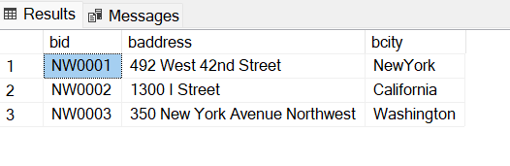
Branch Table
Create Table branch (
bid varchar(10),
baddress varchar(30),
bcity varchar(20),
CONSTRAINT [branch_bid_pk] PRIMARY KEY CLUSTERED
(
[bid] ASC
)
) ON [PRIMARY]
INSERT branch ([bid],[baddress],[bcity]) VALUES ('NW0001', '492 West 42nd Street‘ ,'New York')
INSERT [branch] ([bid], [baddress], [bcity]) VALUES ('NW0002','1300 I Street',' California')
INSERT [branch] ([bid], [baddress], [bcity]) VALUES ('NW0003', '350 New York Avenue Northwest ','Washington')

Slide 4
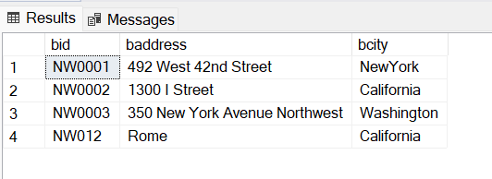
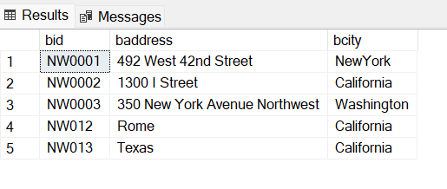
View
create view b_branch as select bid, baddress,bcity from branch
Insert into b_branch values('NW012','Rome','California')
Alter View b_branch
as
Select bid,baddress,bcity from branch
Insert into b_branch values('NW013','Texas','California')

Slide 5
Account Table
Create Table [dbo].[Account](
[acnumber] [varchar] (6) NOT NULL,
[customer_id] [varchar](6) NULL,
[bid] [varchar](6) NULL,
[opening_bal] [int] NULL,
[opening_date] [date] NULL,
[acc_type] [varchar](10) NULL,
[acc_status] [varchar](10) NULL,
[MaxDailyTransAmt] [numeric](10, 2) NULL)
CONSTRAINT [account_acnumber_pk] PRIMARY KEY CLUSTERED
(
[acnumber] ASC
)
) ON [PRIMARY]

Slide 6
INSERT [dbo].[account] ([acnumber], [customer_id], [bid], [opening_bal], [opening_date], [acc_type], [acc_status], [MaxDailyTransAmt]) VALUES (N'0001', N'X0001', N'NW0001', 5000, CAST(N'2022-12-15' AS Date), N'Saving', N'Active', CAST(50000.00 AS Numeric(10, 2)))
INSERT [dbo].[account] ([acnumber], [customer_id], [bid], [opening_bal], [opening_date], [acc_type], [acc_status], [MaxDailyTransAmt]) VALUES (N'0002', N'X0002', N'NW0002', 10000, CAST(N'2022-06-12' AS Date), N'corporate', N'Active', CAST(100000.00 AS Numeric(10, 2)))
INSERT [dbo].[account] ([acnumber], [customer_id], [bid], [opening_bal], [opening_date], [acc_type], [acc_status], [MaxDailyTransAmt]) VALUES (N'0003', N'X0003', N'NW0003', 5000, CAST(N'2022-05-17' AS Date), N'Saving', N'Active', CAST(50000.00 AS Numeric(10, 2)))
INSERT [dbo].[account] ([acnumber], [customer_id], [bid], [opening_bal], [opening_date], [acc_type], [acc_status], [MaxDailyTransAmt]) VALUES (N'N0004', N'X0002', N'NW0004', 5000, CAST(N'2022-01-27' AS Date), N'Saving', N'Active', CAST(50000.00 AS Numeric(10, 2)))
INSERT [dbo].[account] ([acnumber], [customer_id], [bid], [opening_bal], [opening_date], [acc_type], [acc_status], [MaxDailyTransAmt]) VALUES (N'N0005', N'X0006', N'NW0006', 10000, CAST(N'2022-12-17' AS Date), N'corporate', N'Active', CAST(100000.00 AS Numeric(10, 2)))
INSERT [dbo].[account] ([acnumber], [customer_id], [bid], [opening_bal], [opening_date], [acc_type], [acc_status], [MaxDailyTransAmt]) VALUES (N'N0006', N'X0007', N'NW0007', 5000, CAST(N'2022-08-12' AS Date), N'Saving', N'Suspended', CAST(50000.00 AS Numeric(10, 2)))
INSERT [dbo].[account] ([acnumber], [customer_id], [bid], [opening_bal], [opening_date], [acc_type], [acc_status], [MaxDailyTransAmt]) VALUES (N'N0007', N'X0007', N'NW0001', 5000, CAST(N'2022-10-02' AS Date), N'Saving', N'Active', CAST(50000.00 AS Numeric(10, 2)))
INSERT [dbo].[account] ([acnumber], [customer_id], [bid], [opening_bal], [opening_date], [acc_type], [acc_status], [MaxDailyTransAmt]) VALUES (N'N0008', N'X0001', N'NW0003', 10000, CAST(N'2022-11-09' AS Date), N'corporate', N'Terminated', CAST(100000.00 AS Numeric(10, 2)))
INSERT [dbo].[account] ([acnumber], [customer_id], [bid], [opening_bal], [opening_date], [acc_type], [acc_status], [MaxDailyTransAmt]) VALUES (N'N0009', N'X0003', N'NW0007', 5000, CAST(N'2022-11-30' AS Date), N'savings', N'Terminated', CAST(50000.00 AS Numeric(10, 2)))
INSERT [dbo].[account] ([acnumber], [customer_id], [bid], [opening_bal], [opening_date], [acc_type], [acc_status], [MaxDailyTransAmt]) VALUES (N'N0010', N'X0004', N'NW0002', 10000, CAST(N'2022-03-01' AS Date), N'corporate', N'Active', CAST(100000.00 AS Numeric(10, 2)))

Slide 7
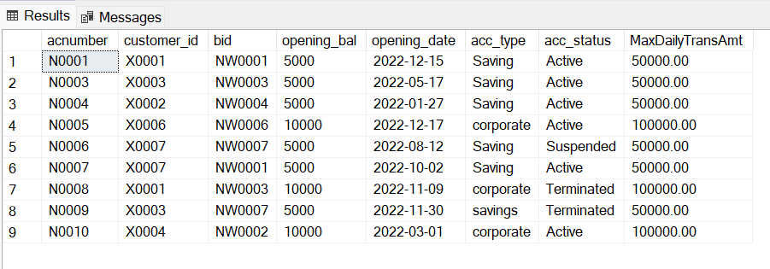
Select * from Account

